Slide 1

Notes:
(Introduce yourself)

Slide 2







Notes:
How many of you have learned about Internet safety before?
(Pause for audience response.)
Although you may have already heard about some of these things we’ll be discussing, it’s always important to hear them again. Why?
As you get older, you’ll be facing more and more of these issues.
The Internet is always changing, so you might need new ways to safer.
Practice makes perfect!
Today we’ll be talking about:
How posting something inappropriate online can have serious consequences.
What kind of personal information is not OK to post and how to protect your privacy.
What to do if you get unwanted requests from an older teen or adult.
Why we all need to work together to stop cyberbullying.

Slide 3












Notes:
What are some of the things you like to do online?
(Pause for audience response. If you need to prompt the audience, use the questions below. Take note of their answers and tailor your presentation to their current interests.)
How many of you like to:
Text or play games on your cell phone or your parent’s phone?
Use Google to help with your homework?
Game online with a computer, PlayStation 4 or Xbox?
Download music from iTunes?
Watch videos on YouTube?
Play in a virtual world like Club Penguin or Minecraft?
Chat with family and friends on Skype?
Use a social media site or app like Instagram or Twitter? (NOTE: Many social media sites require their users to be 13 or above, although children under 13 may have accounts.)

Slide 4
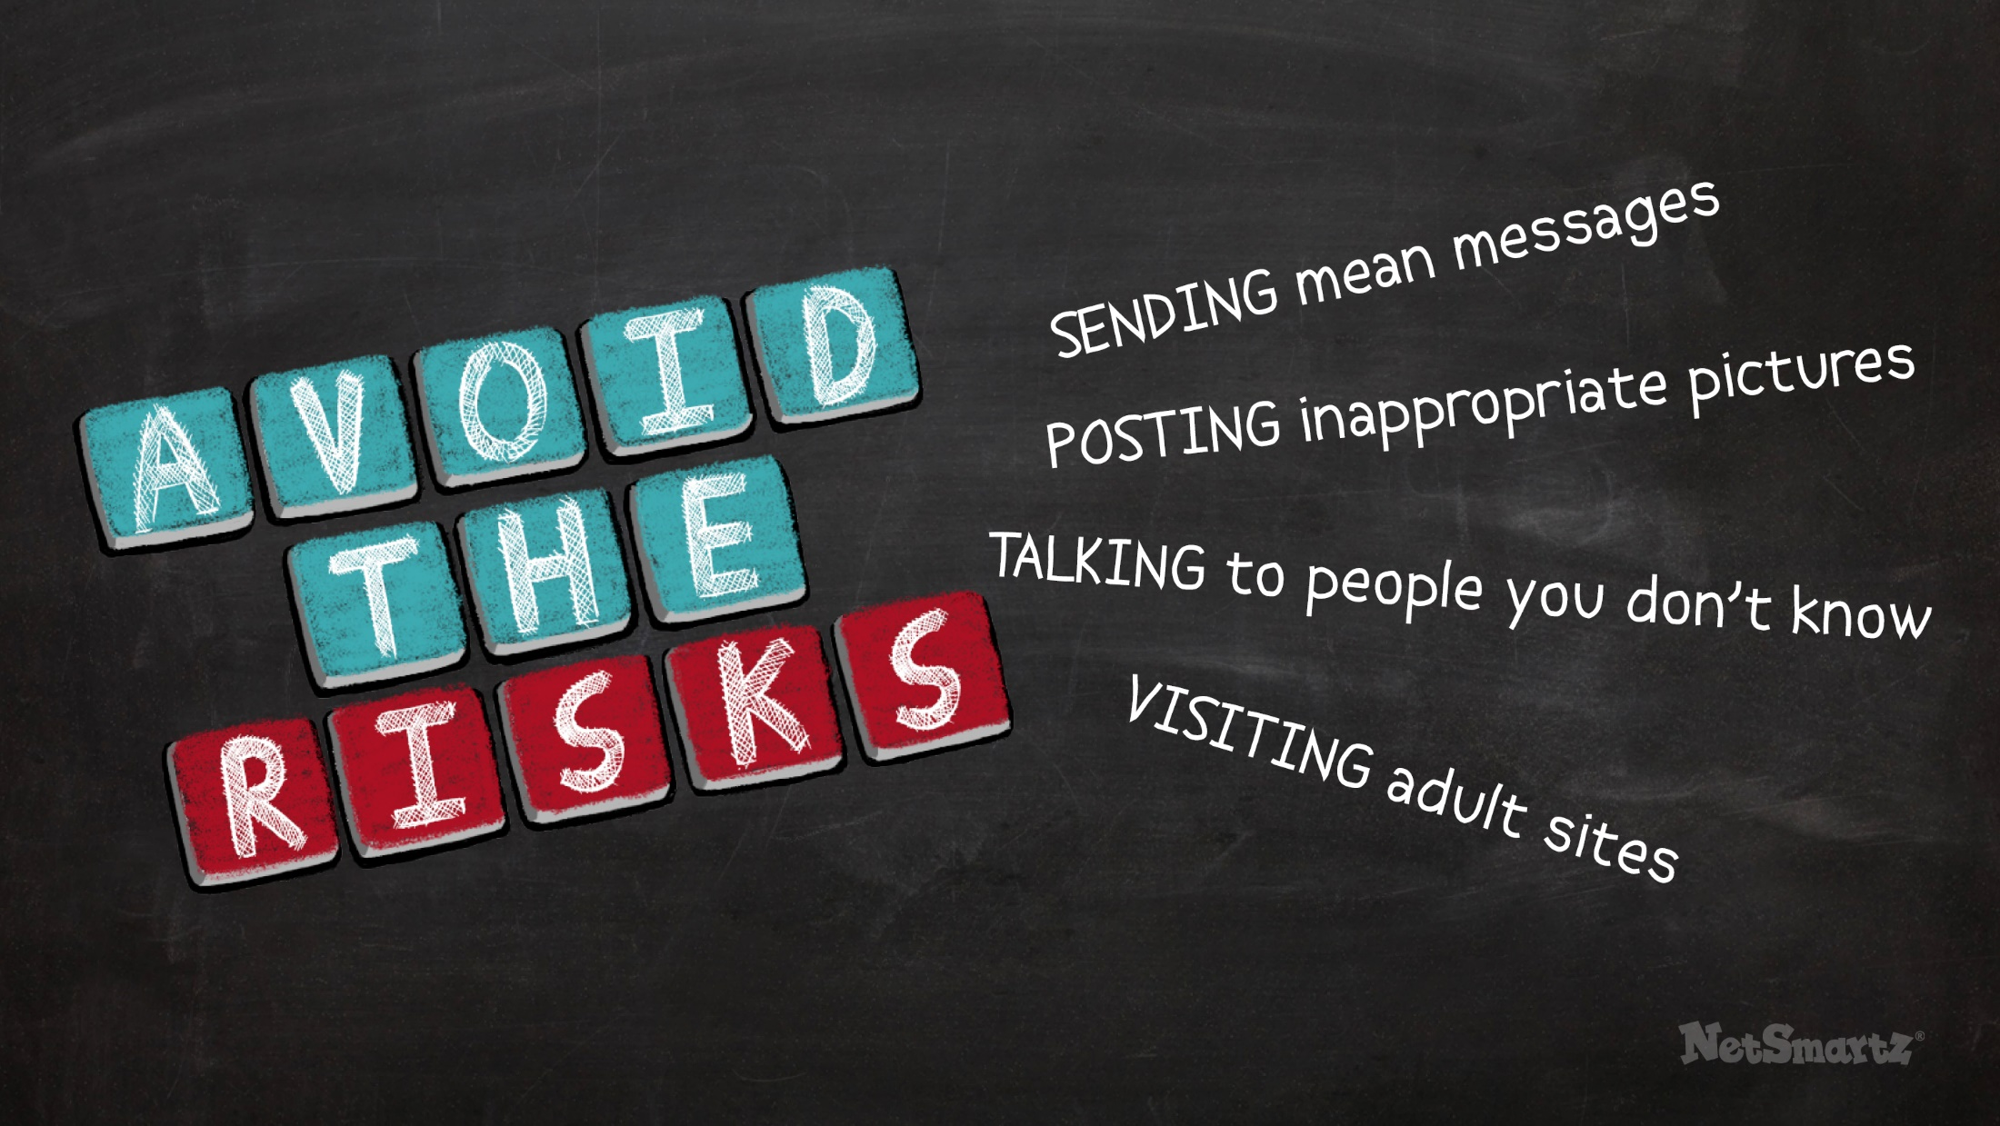

Notes:
No matter what you like to do online, there’s one rule that applies to any situation: avoid the risks! Some examples of taking risks are:
Sending mean messages.
Posting inappropriate pictures.
Talking to people you don’t know.
Visiting adult sites.
All of these are risky because you might get into trouble for doing them or you might be putting yourself in danger. Protect yourself by making responsible choices. This will help you avoid risks.

Slide 5
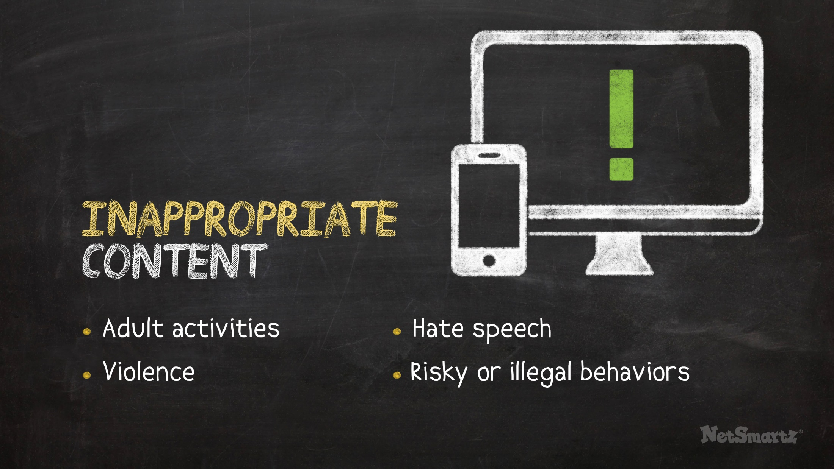



Notes:
Seeing things you don’t want to see is one of those risks. You can find tons of things online, but some of those things you aren’t ready to see. These things are considered inappropriate content.
Inappropriate content includes:
Adult activities.
Violence.
Hate speech.
Risky or illegal things like dangerous stunts or drinking games.
It may seem cool to look up this type of content, but there is a reason it's not for kids. It could make you feel bad, confused, uncomfortable or even scared so you shouldn't look at it up or open these kinds of links from friends.

Slide 6

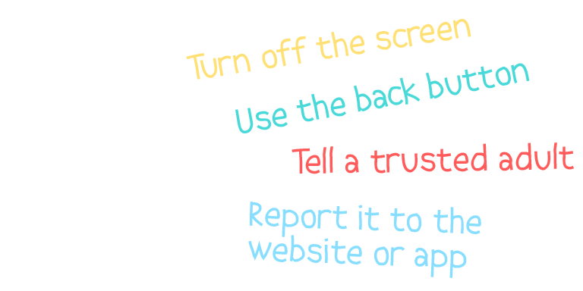
Notes:
If you do come across inappropriate content online, you can:
Turn off the screen.
Use the back button.
Tell a trusted adult if you feel upset or want to talk about it.
Report it to the website or app where you found it or report it to the CyberTipline

Slide 7
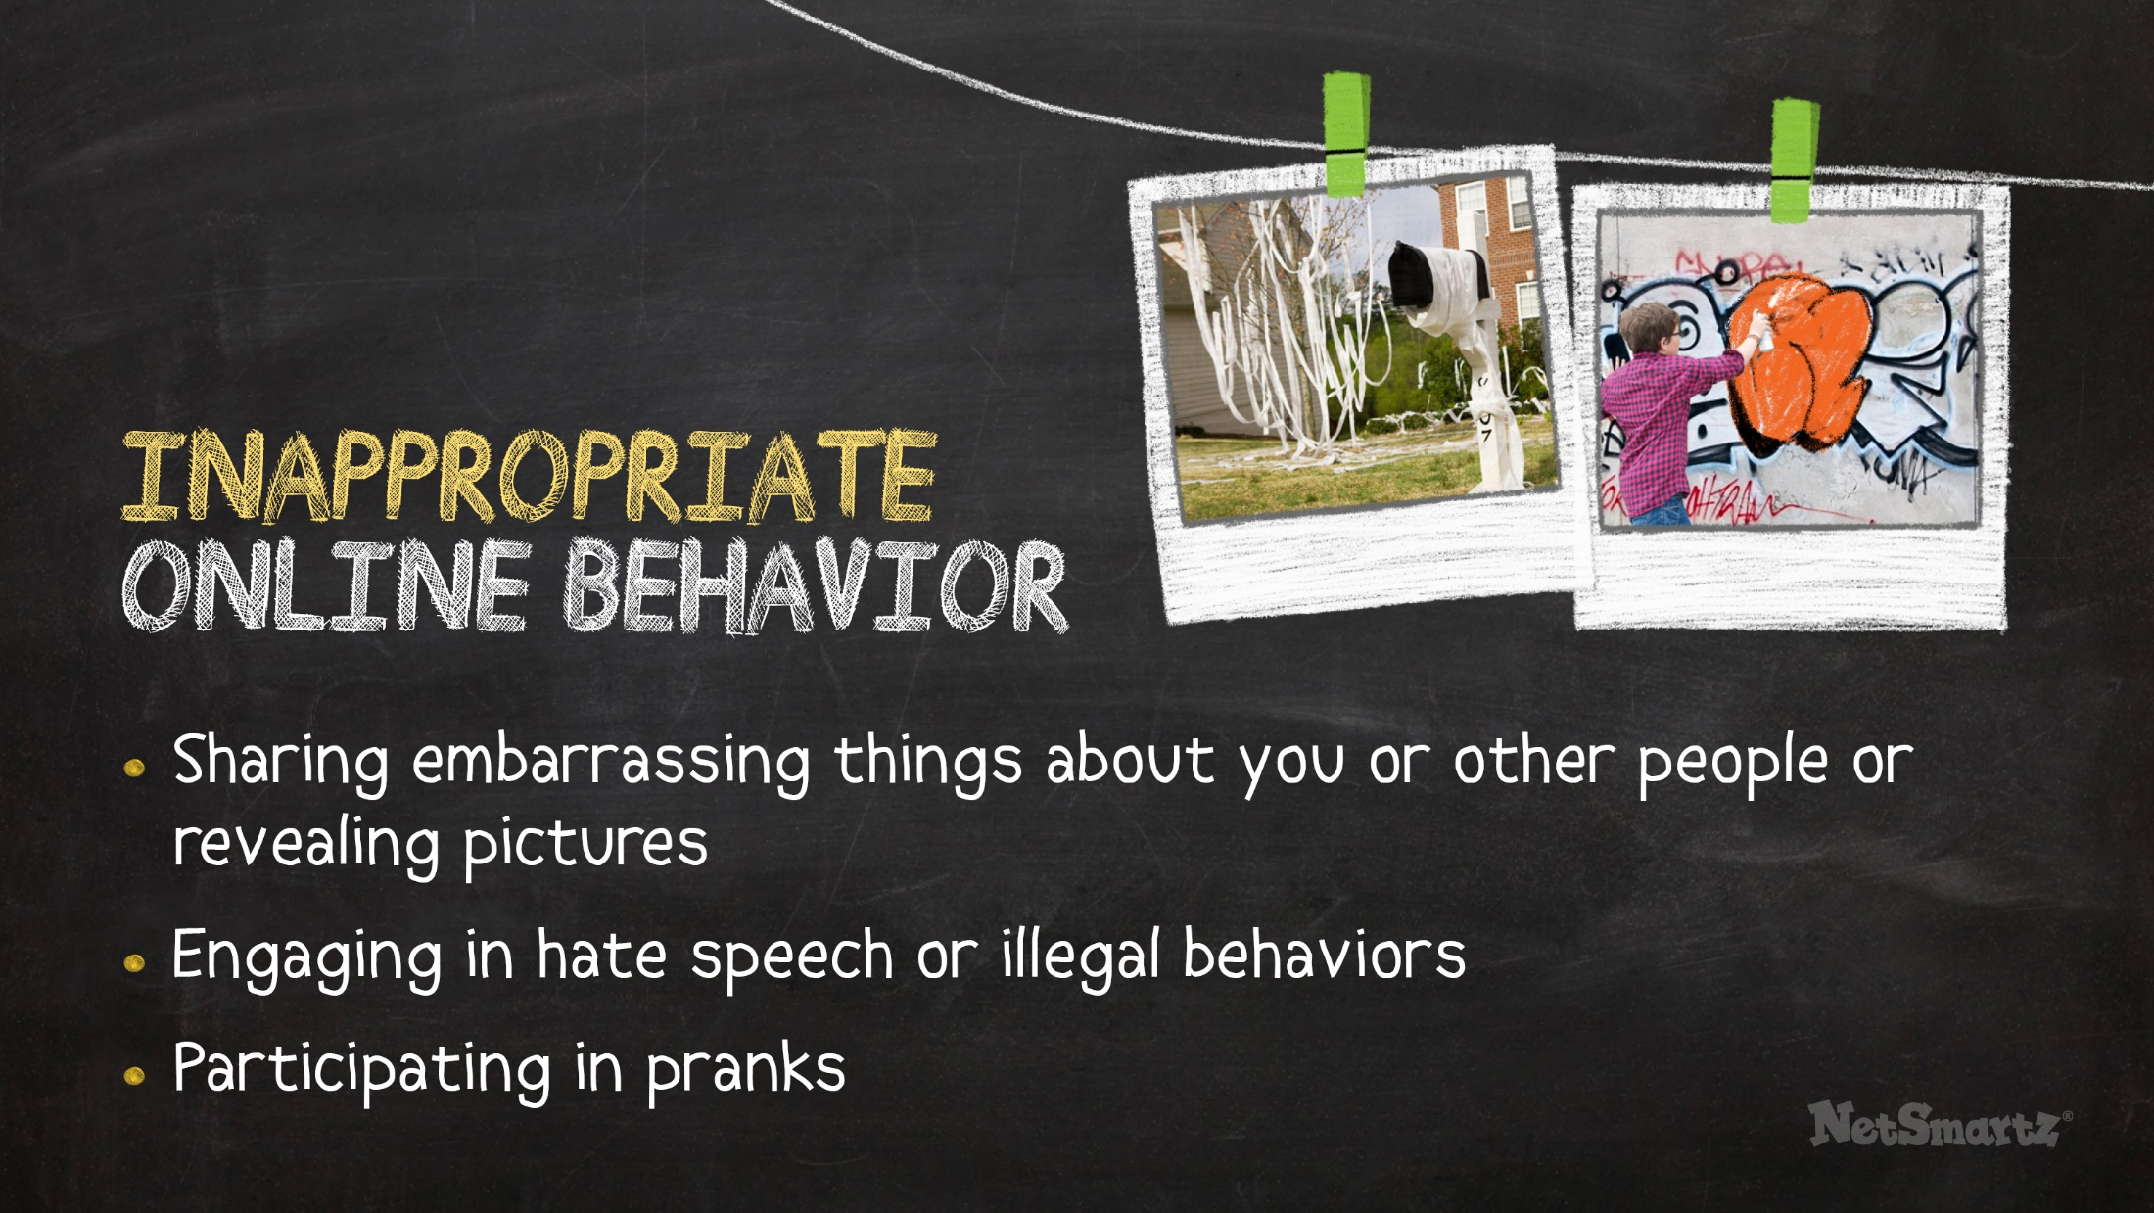


Notes:
Now that you’re older, you’re not only seeing things online, you’re posting things too. So be sure you aren’t posting anything inappropriate.
Inappropriate information that you shouldn’t share online includes:
Embarrassing things about you or other people.
Revealing pictures.
Pranks.
Illegal behavior (drugs, alcohol, etc.).
Hate speech.
Posting these things online means you may:
Get a bad reputation.
Be punished at home, at school or even by the law.
Hurt your chances of getting into college or getting a job in the future.
Examples from the news
Two middle school students in TX posted messages threatening their classmates on Facebook. They received an in-school suspension and were required to do community service. ¹
A middle school student in PA was charged with serious crimes after he posted a video to YouTube of himself vandalizing the school bathroom.²

Slide 8
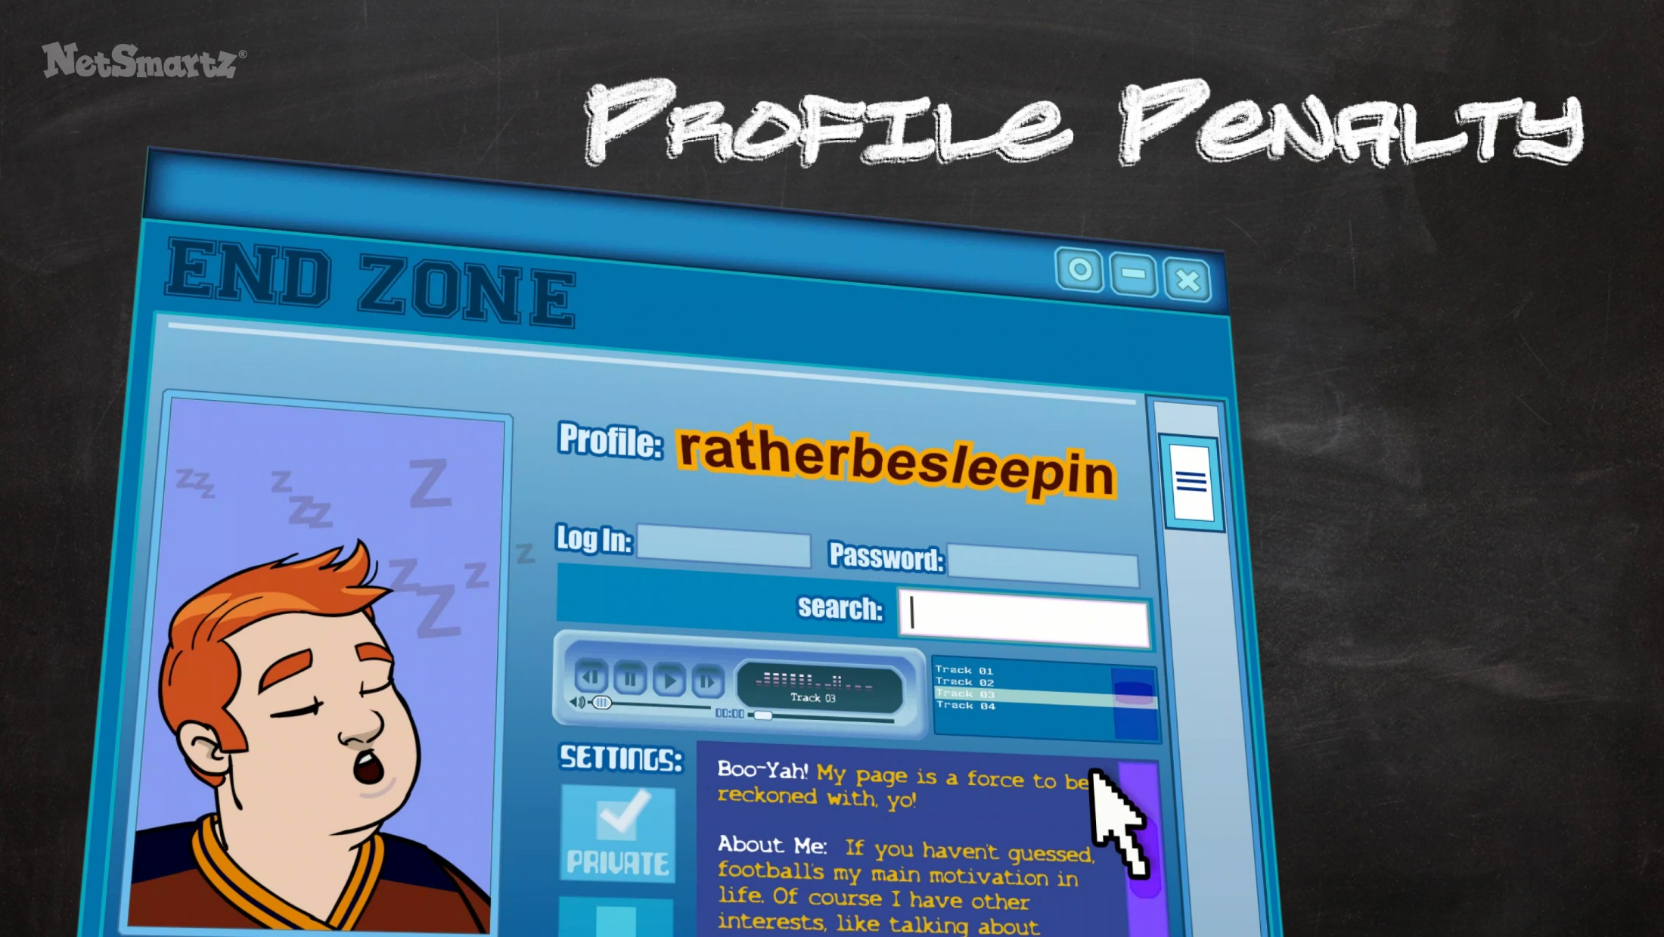
Notes:
In this next video, you’ll see how a football player named Tad worries that the information he’s posted online might hurt his chances of being recruited. While most of the things Tad posts are silly, they aren’t going to give coaches and recruiters the best impression of him. It’s important to remember that what you post online can be seen as a reflection of who you are.
(Click to show video.)

Slide 9

Notes:
(Video plays.)

Slide 10

Notes:
Remember to think before you post. Once you post something online, you can’t take it back. One good trick is to ask yourself, “Do I want my parents, grandparents or teachers seeing this?” If not, you shouldn’t post it.

Slide 11

Notes:
You should also try to protect your privacy online. Avoid posting too much online - that includes information and pictures. Revealing too much about yourself online is risky because:
It can spread very quickly.
It can reach people you may not want it to.

Slide 12
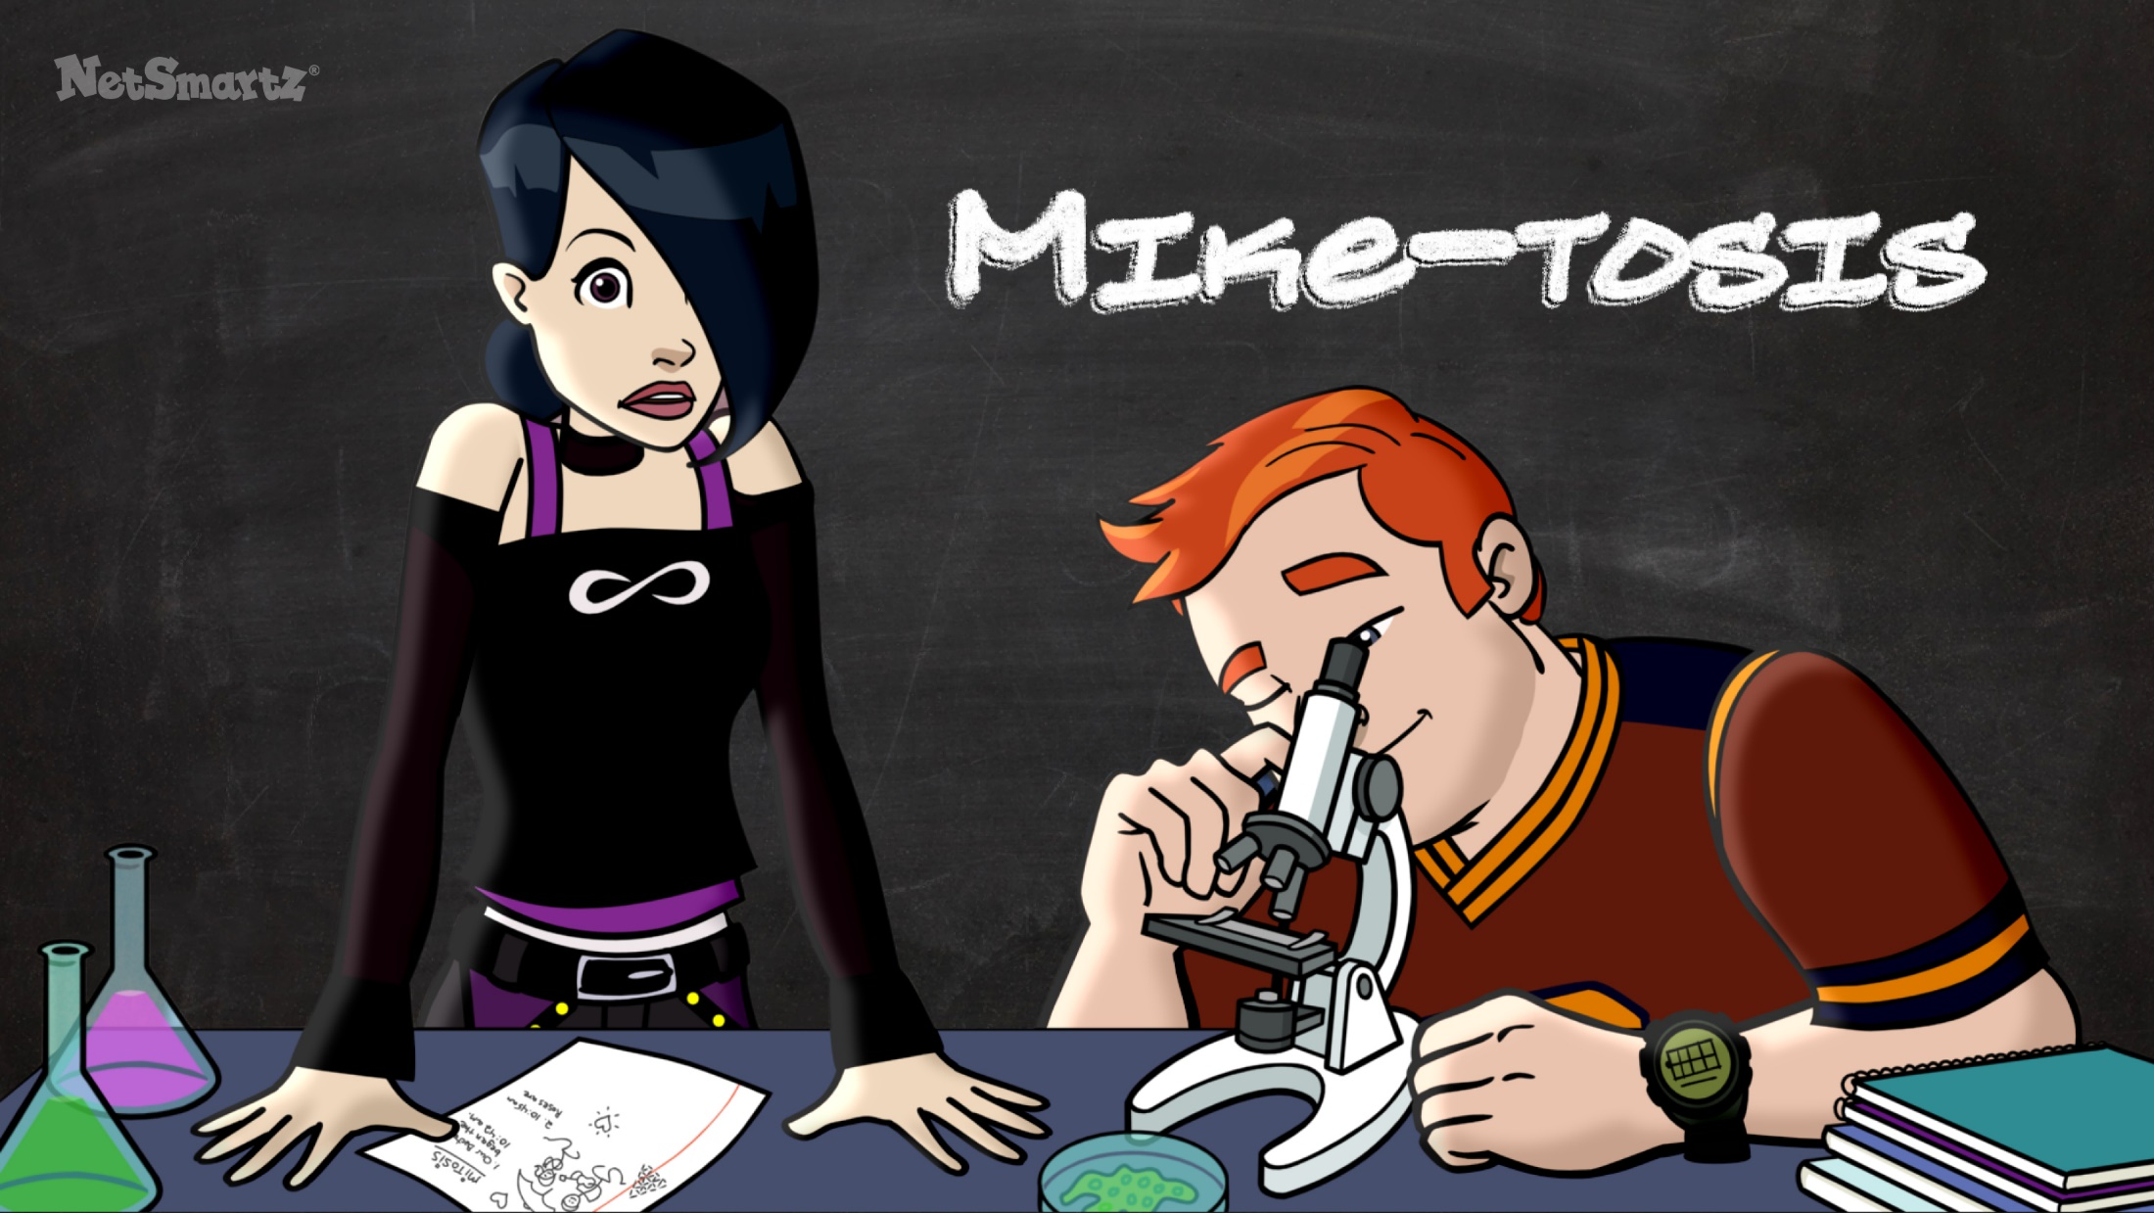
Notes:
In this video, you’ll see how one text message gets out of control and spreads much faster than anyone can keep up with.
(Click to show video.)

Slide 13

Notes:
(Video plays.)

Slide 14
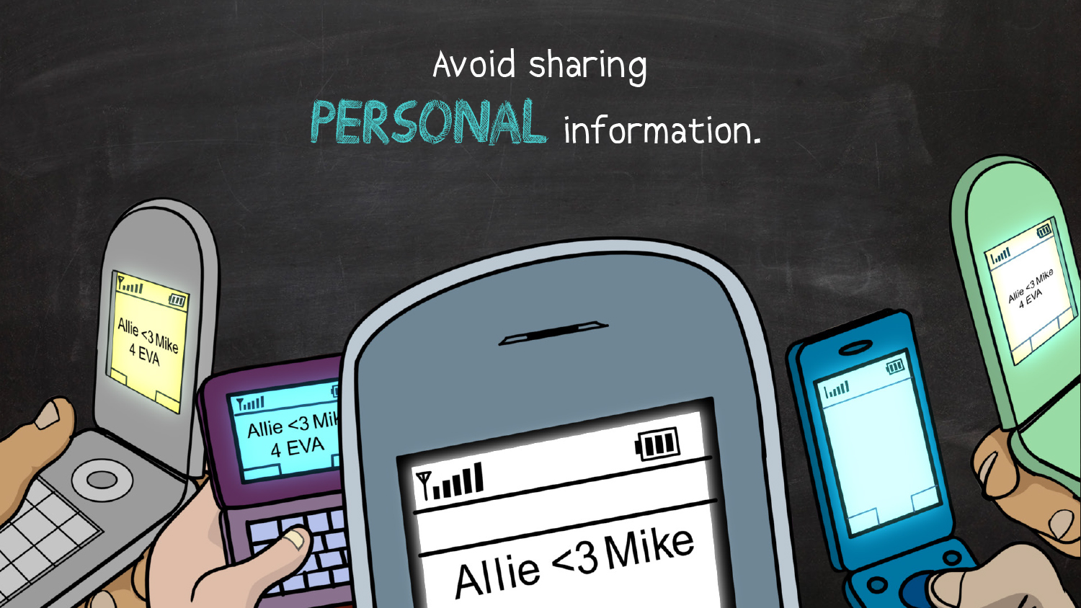
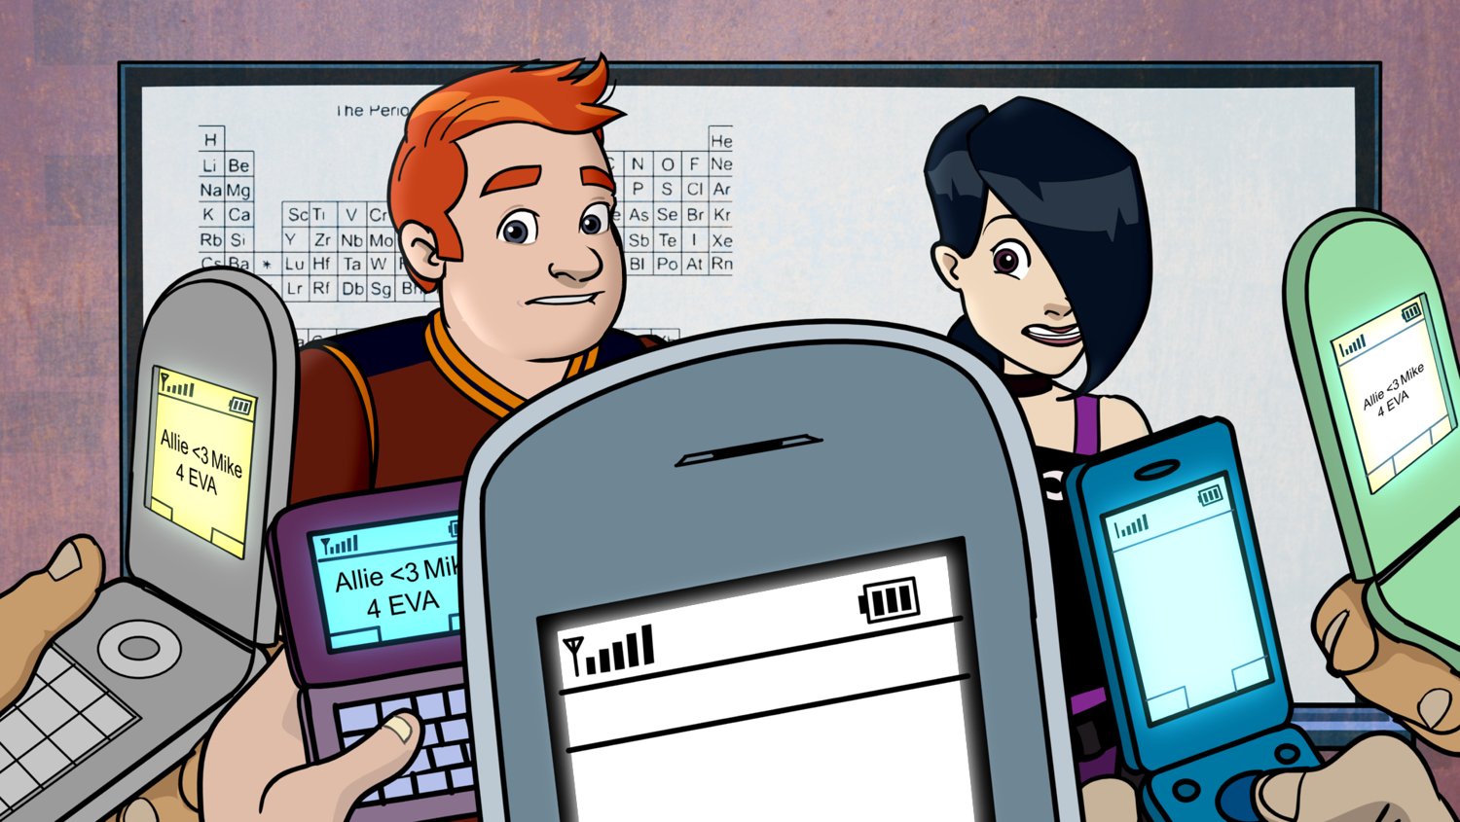
Notes:
Did you see how quickly the rumor about Allie’s crush spread around the school? That’s why you want to avoid sharing too much online - because it can spread very fast and quickly get out of control.
You might not mind sharing certain types of information, like your favorite movie, but you definitely don’t want to share personal information.
Suggested activity
Have everyone play the telephone game to show how easy it is for things that spread online to become distorted.

Slide 15

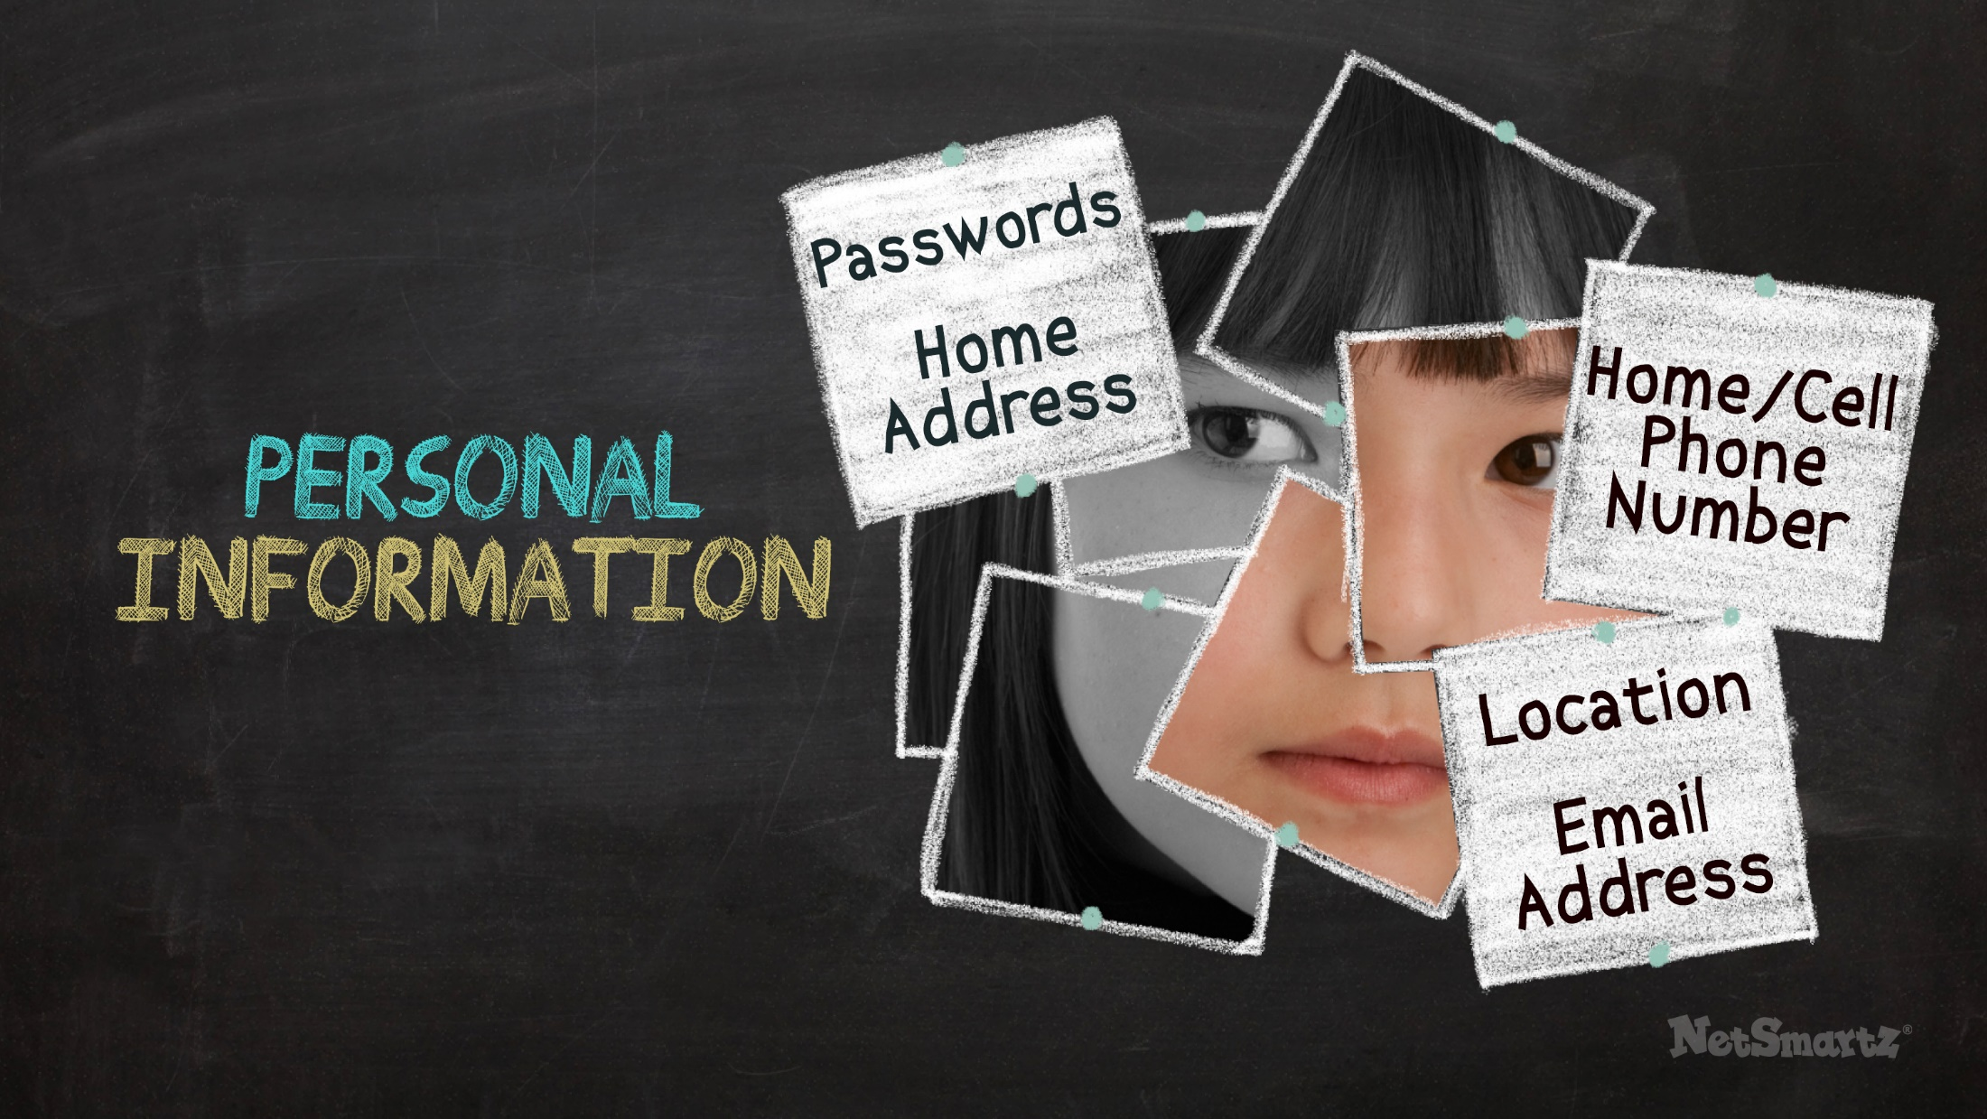

Notes:
Personal information that you shouldn’t share online includes your:
Passwords
Home address
Location
Home/cell phone number
Email address
Everything you post online can potentially be seen by a lot of people, so you have to be careful about what you tell and who you tell. Sharing personal information online is a security risk. You could:
Become the victim of an online scam.
Or have your computer or online accounts hacked.
Be careful not to share personal information with anyone. You should also be careful not to share your family or friends’ personal information online either. Here are two examples of when you should avoid sharing someone else’s personal information:
One friend asks you for another’s phone number. Don’t post it online! Call them with the number instead.
Your friend asks for your email password because she says best friends share everything. Don’t share your password! The only person it’s OK to share your password with is your parent or guardian.

Slide 16
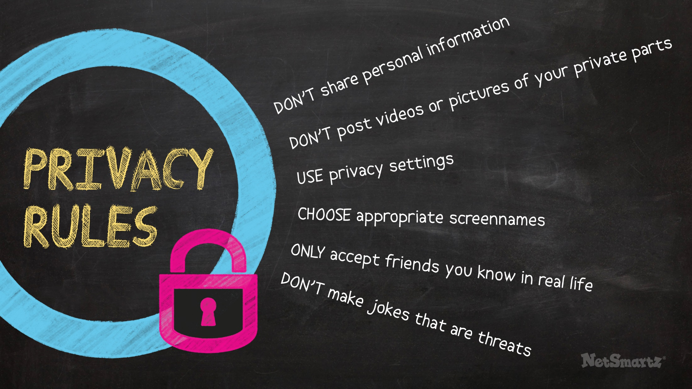

Notes:
As you saw, Tad decided to clean up his profile when his friend pointed out that some posts made him look immature. How many of you:
Have a profile on a social media site or app like Facebook, Instagram or Twitter?
Play in a virtual world like Neopets or Runescape?
Have a gaming account with Xbox or PlayStation?
(Pause for audience response.)
For all of these online accounts, you want to be sure you’re not sharing too much. Here are some tips to avoid revealing too much online:
Don’t share personal information - Remember, that includes your address, phone numbers, passwords and schedule.
Use privacy settings and check them often - That means setting your page to private and limiting who can see your posts and pictures.
Choose appropriate screennames - You don’t want to give the wrong impression, so pick something that’s not embarrassing or offensive.
Only accept friends you know in real life - That goes for “friends of friends,” too. If you don’t know them, don’t add them!
Don’t make jokes that are threats - They can be taken out of context and you can get in serious trouble.

Slide 17
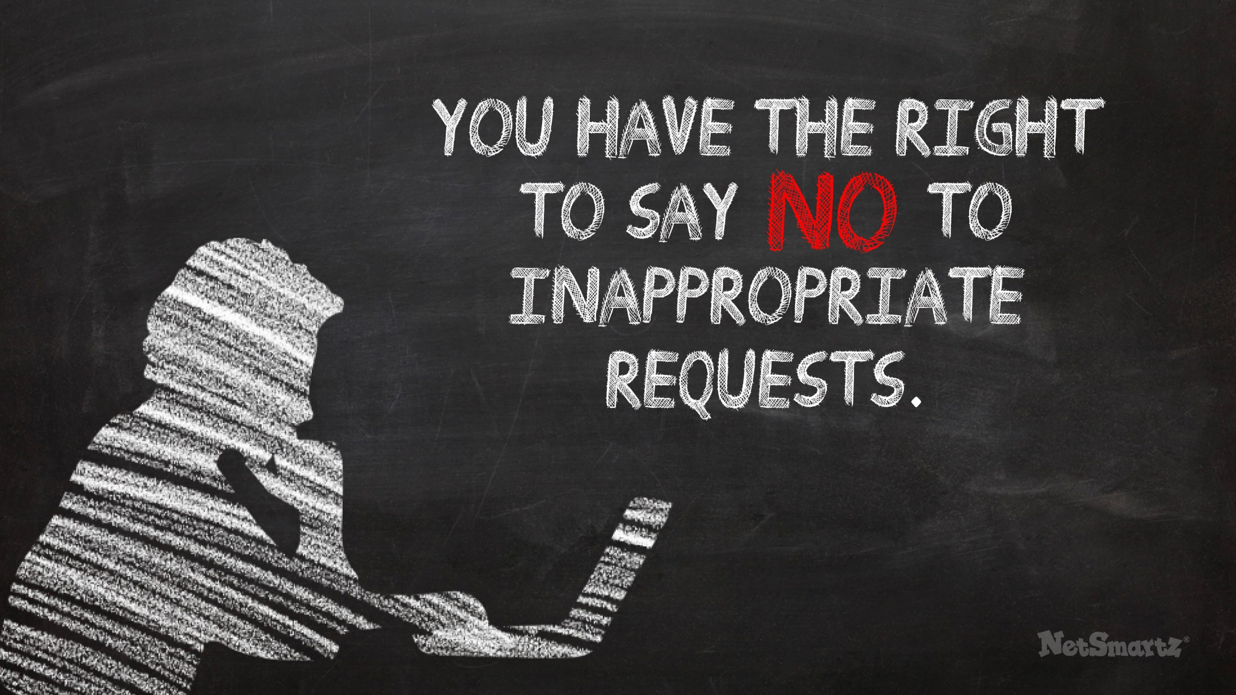
Notes:
Now let’s move from what you’re doing online to who you’re talking to. It’s important to understand that some people don’t have the best intentions and may ask you to do things you don’t want to do. This is called an inappropriate request.
Here are some examples of inappropriate requests:
You’re in a video chat with friends and one of them jokingly asks you to pull up your shirt.
Someone emails you a link to an adult website they want you to see.
No matter who makes the request - an older teen, an adult, a stranger or a friend - you don’t have to do it. Some kids are bothered by these requests, others aren’t. But you all have the right to say “no.”

Slide 18

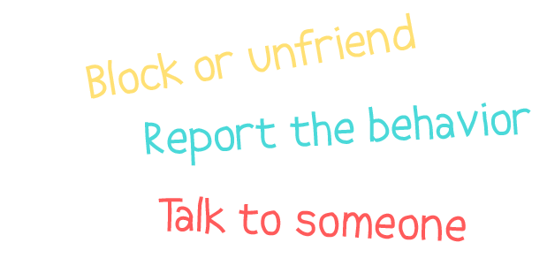
Notes:
If anyone is sending you unwanted requests, you should:
Block or unfriend them.
Report any inappropriate behavior to the website or app you’re using.
Tell an adult you trust.

Slide 19
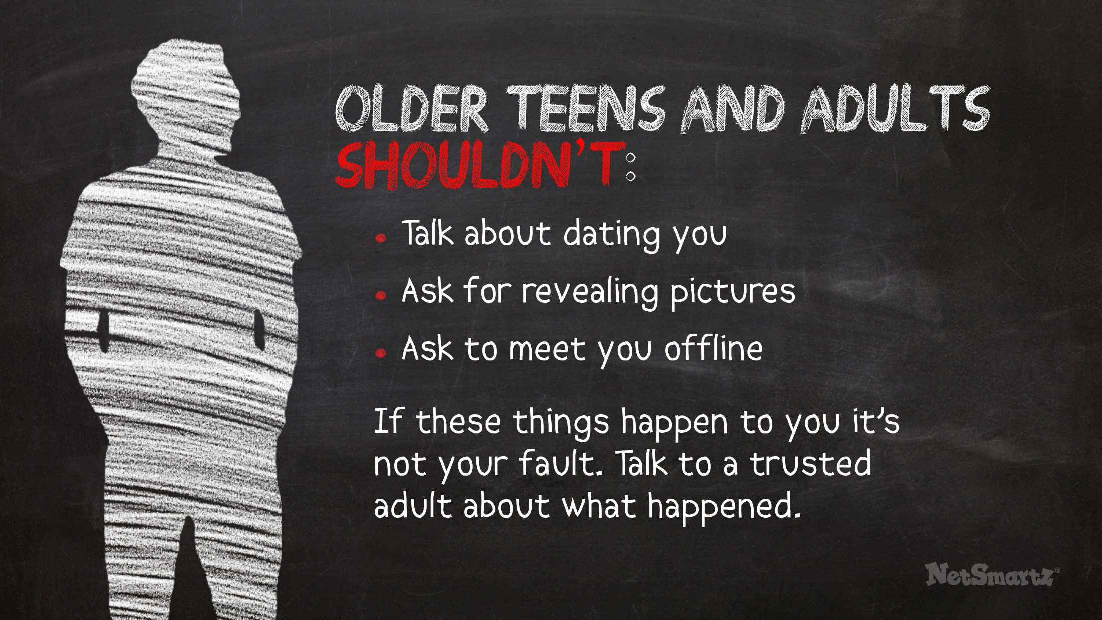
Notes:
Sometimes inappropriate requests develop into more dangerous relationships. You may talk to older teens and adults you don’t know online when you’re doing something like playing a game, but they should never:
Talk about dating you.
Ask for revealing pictures of you.
Ask to meet you offline.
If one or more of these things happen to you tell a trusted adult and report what happened to the app or website. You can also report to the CyberTipline at www.cybertipline.org

Slide 20
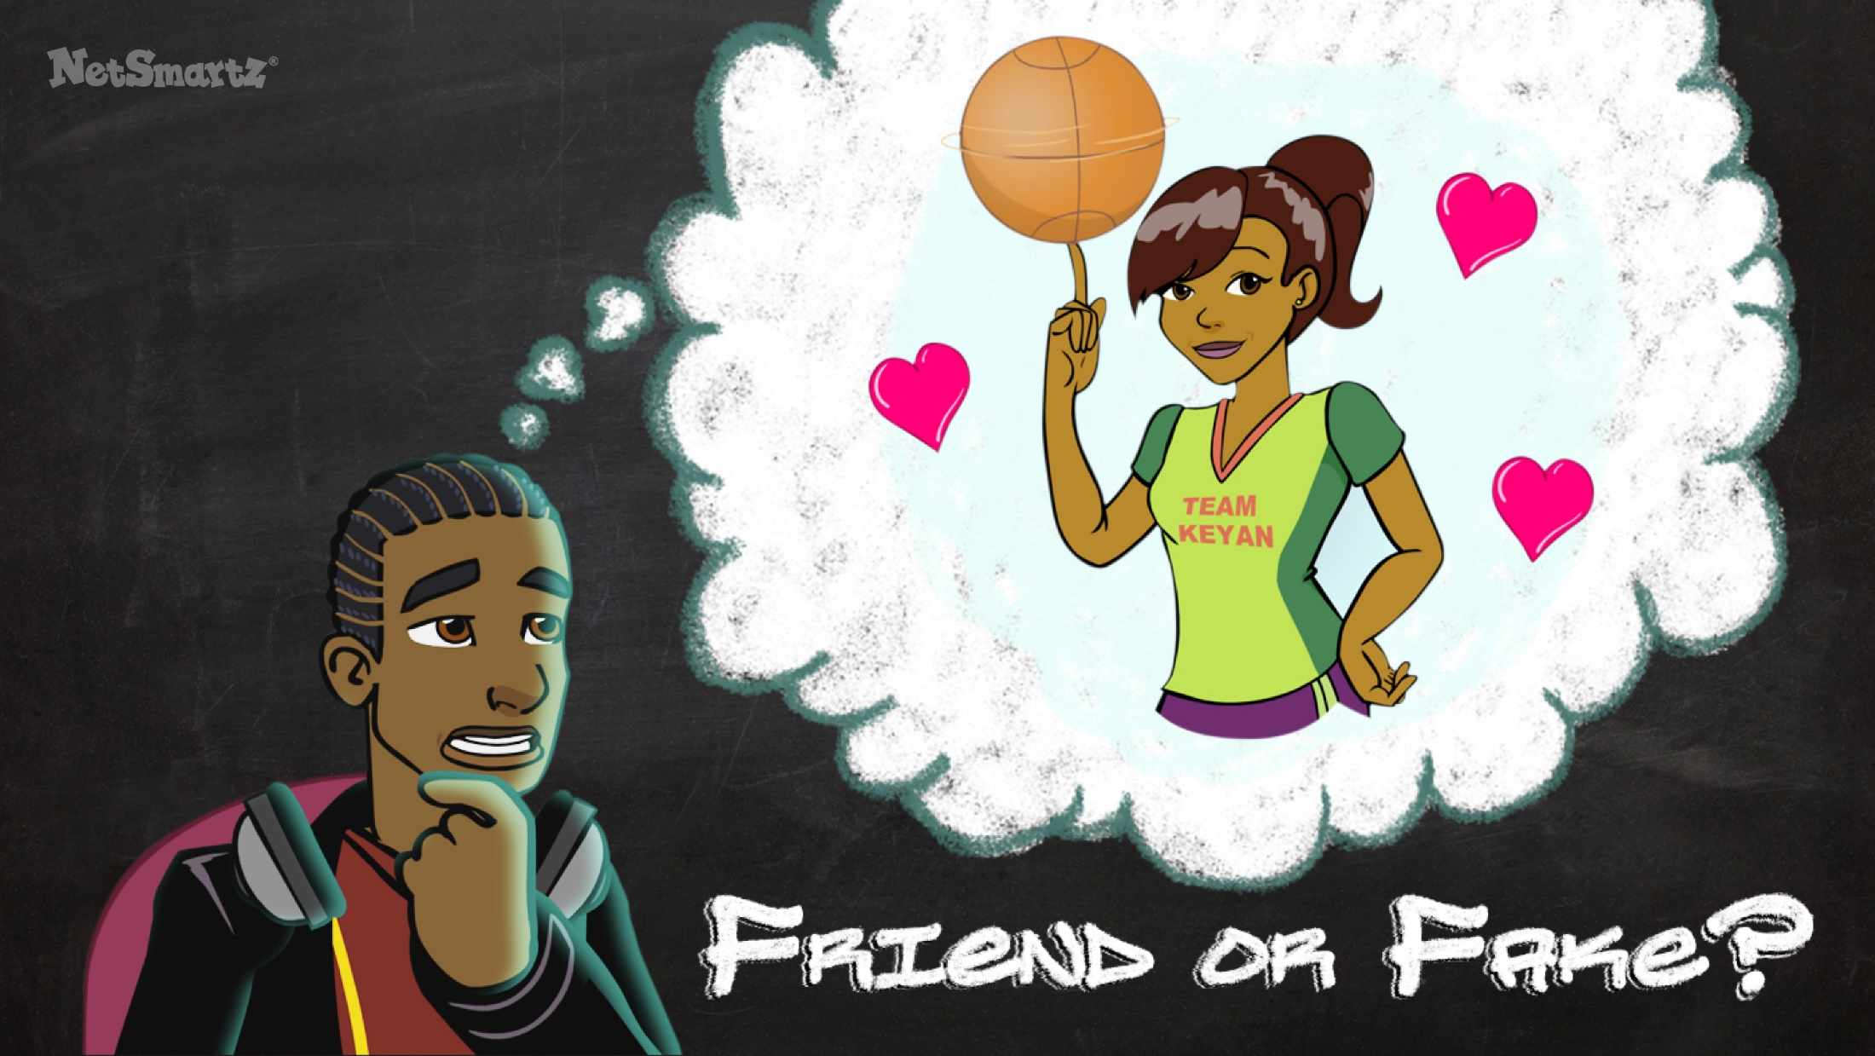
Notes:
Not everyone online has bad intentions, but you should still be careful when talking to people you don’t know. And even if the request doesn’t come from an adult, you shouldn’t meet offline. Watch this video to see how Keyan’s new online friend raises some red flags for his friends.
(Click to show video.)

Slide 21

Notes:
(Video plays.)

Slide 22
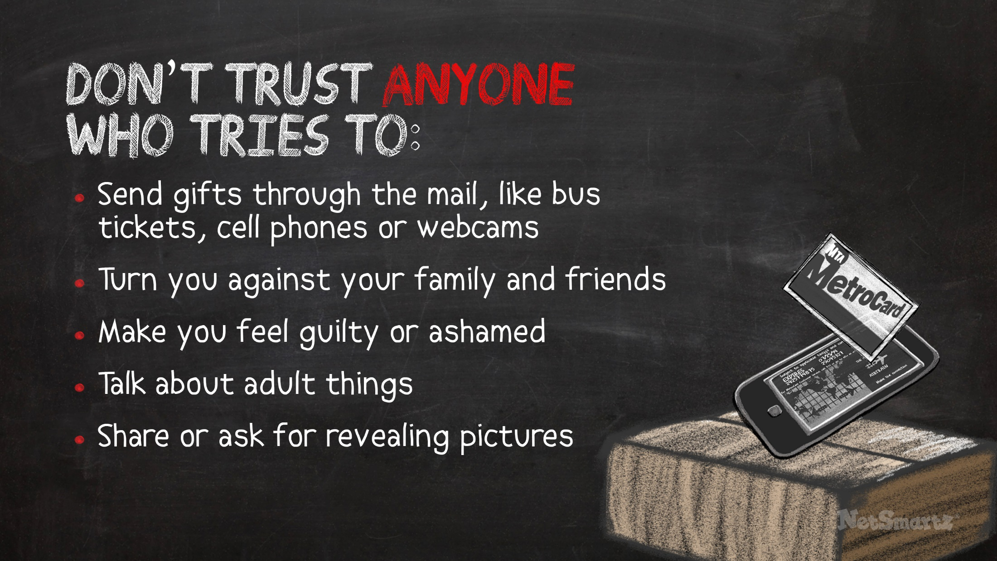
Notes:
Not only did Tracy ask to meet offline, she did things that made Keyan’s friends question her intentions. Some people may try to meet you offline by flattering you and pretending they care. This is called “grooming.” Don’t trust anyone who tries to:
Send gifts through the mail, like bus tickets, cell phones or webcams.
Turn you against your family and friends.
Make you feel guilty or ashamed.
Talk about adult things.
Share or ask for revealing pictures.
If these things have happened to you it is not your fault. Talk to a trusted adult about what happened.
Examples from the news
A 12-year-old girl in OH began chatting with an older man on Kik. He asked her to send revealing pictures of herself using her cell phone. She sent the pictures and he was arrested.³
A 14-year-old boy in MD met up with a man he had been chatting with online. He thought he was chatting with a 16-year-old. The boy called the police after their visit and the man was arrested. ⁴

Slide 23
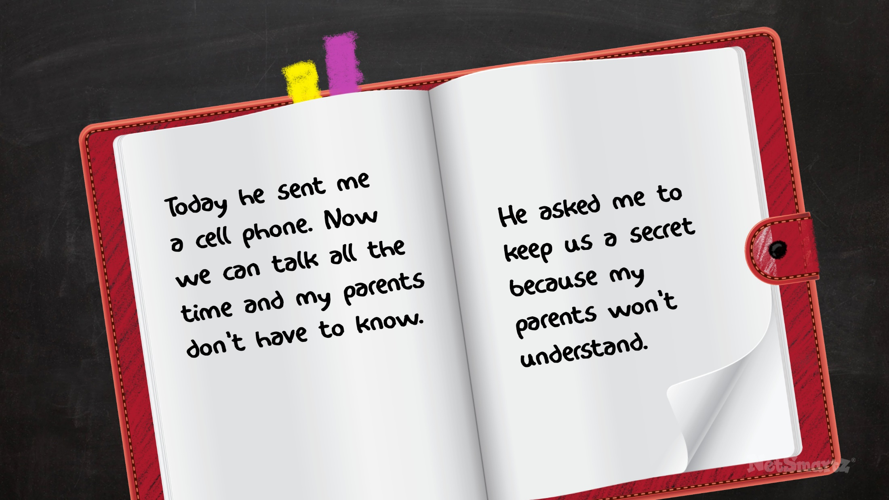
Notes:
Take a look at this journal entry from a teen writing about someone they met online:
“Today he sent me a cell phone. Now we can talk all the time and my parents don’t have to know. He asked me to keep us a secret because my parents won’t understand.”
Can you see any signs that the teen is being groomed?
(Pause for audience response. If you need to prompt the audience, use the answers below.)
Grooming signs include:
Getting a cell phone.
Talking all the time.
Keeping secrets from parents.
Thinking parents won’t understand.
Suggested activity
Have students brainstorm with the person next to them three things they would say to a friend who was forming a relationship like this with someone online. What would they say to convince their friend it wasn’t a good idea?

Slide 24


Notes:
If someone you met online is asking you to do things that make you uncomfortable or is trying to get you to meet in person, there are many things you can do. You should:
Block them.
Not accept them as a friend.
Not agree to meet them offline.
Tell a trusted adult.
Remember that the same person may be doing the same things to a child who is younger than you. By reporting the behavior you can protect others.
It may be hard to tell an adult because:
You’re afraid they won’t let you go online anymore.
You may not think an adult can help.
It may be awkward to tell them what’s been going on.
You’re afraid they’ll blame you.
Even though it’s hard, it’s important to talk to an adult you trust, like your parent, another relative, a teacher or a counselor at school. Adults should not be talking to kids online and making them uncomfortable, but you have the power to stop them by telling someone.

Slide 25
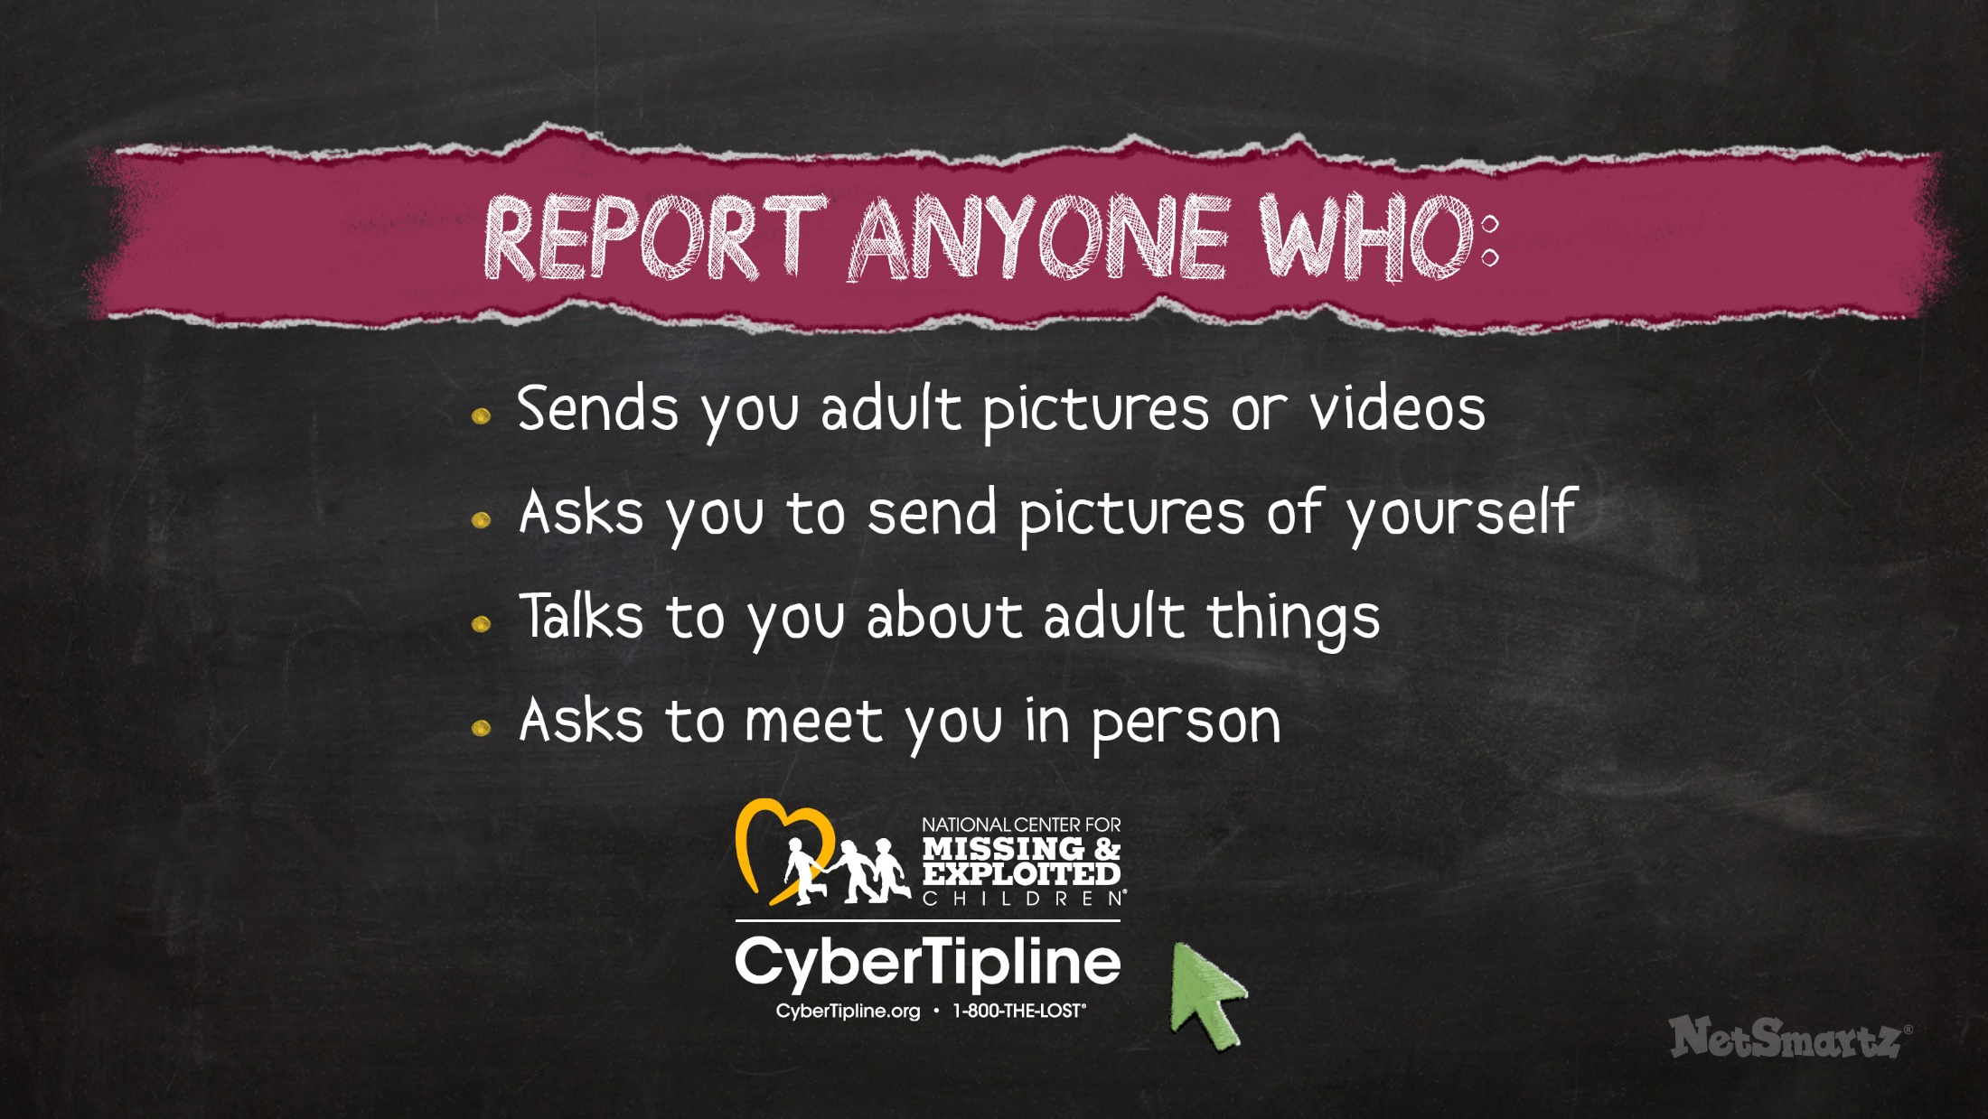
Notes:
Together with an adult you trust, visit CyberTipline.org to report anyone who:
Sends you adult pictures or videos.
Asks you to send pictures of yourself.
Talks to you about adult things.
Asks to meet you in person.
Reporting means you’re standing up for yourself and making sure these people don’t bother anyone else.

Slide 26

Notes:
The next risk we’re going to talk about is probably something you’re already familiar with. Cyberbullying is exactly what it sounds like - the combination of bullying and technology.
Some examples of cyberbullying are:
Sending mean text messages.
Spreading rumors online.
Creating fake profiles to make fun of someone.
Recording and posting fight videos.
Photoshopping pictures to make someone look bad.
Trash talking someone in an online game.
Sometimes people cyberbully others because:
They think it’s funny.
They don’t like someone and want to hurt their feelings.
They think someone is different and call them mean words, like “gay.” (Share this only if you judge the tweens to be mature enough to discuss it or if they have already mentioned it themselves.)
The good news is that most kids aren’t involved in cyberbullying, but it’s still a serious problem that everyone here needs to think about.
Suggested activity
Ask students to name some examples of cyberbullying they’ve seen. If they aren’t comfortable sharing, they can use fake names.

Slide 27
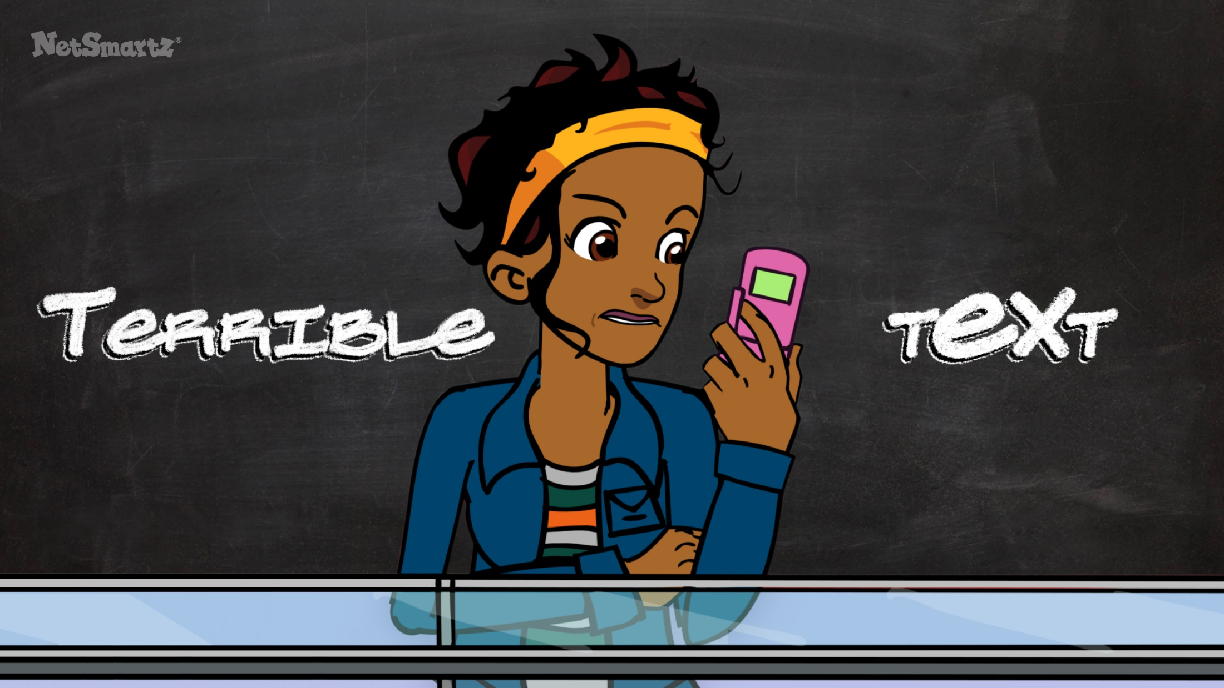
Notes:
In this video, you’ll see how Lolo feels when she starts receiving mean text messages on her cell phone.
(Click to show video.)

Slide 28

Notes:
(Video plays.)

Slide 29

Notes:
Sometimes people don’t really understand just how much cyberbullying can hurt. Someone who is cyberbullied might:
Feel sad and alone, like Lolo in the video.
Try to avoid school so they don’t have to face their bullies.
Think the bullying will get worse if they tell someone.
Believe that no one can help.
(Share the following if you judge the audience to be mature enough to discuss it or if they have already mentioned it themselves. If they have mentioned it, then they are curious and may have heard some incorrect information that you should dispel.)
You might have also heard some stories in the news about kids who have been cyberbullied and committed suicide. There are a few important things to remember about these cases:
Most kids who are cyberbullied do not try to hurt themselves; these are extreme cases that have made the news, but they are not common.
Kids who do hurt themselves are usually dealing with other problems, too, not just bullying.
You never know what other problems someone has going on, so it’s important you don’t add to them by bullying.
(If your state has a local suicide hotline, you may want to share the contact information here. Or, you may want to share the National Suicide Prevention Lifeline, 1-800-273-8255. )

Slide 30
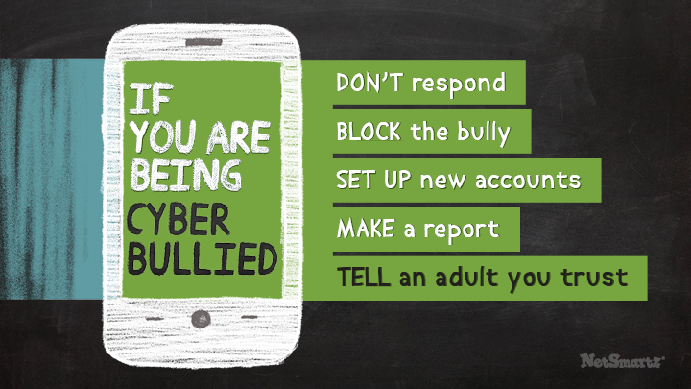

Notes:
If you are being cyberbullied, here are some steps you can take:
Don’t respond to the messages - That will only make it worse.
Block the bully - Most websites and cell phone companies have options for blocking other users.
Set up new accounts - Only give the new account information to people you trust.
Make a report to the website where the bullying took place - Most websites have ways to report cyberbullies and will remove offensive posts.
Tell an adult you trust - Adults don’t always have all the answers, but they really want to help!
Remember, if someone is being hurt, it’s never wrong to tell an adult. Adults can help by:
Listening to you - Sometimes just talking about it can help.
Saving evidence - They can help you figure out if you need to save the messages and who to report them to.
Talking to the school - If you’re being bullied by a classmate, your teachers should know so they can help protect you during the school day.
Setting up new accounts for you - You’ll especially need their help if you need to change your cell phone number.

Slide 31
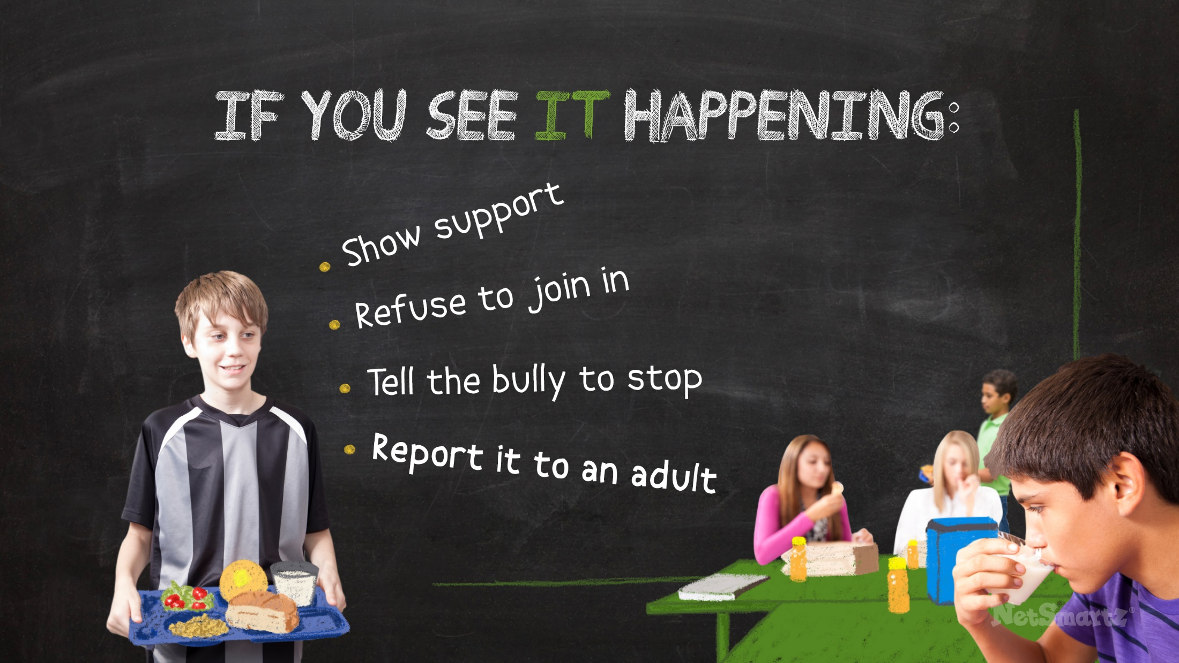
Notes:
Even if you haven’t been cyberbullied yourself, you might have seen it happening to other people. Ignoring it makes you a bystander - that means you stand by and watch while others are being hurt. Upstanders are people to step up to help others. Bystanders are sometimes afraid to speak up because:
They think the bully might target them next.
They don’t think adults can help.
They don’t want to be seen as a tattletale.
If you see cyberbullying happening, you do have the power to stop it. Here are some ways you can help:
Show support for the person being bullied - This might mean making an extra effort to be nice to them, sending them a friendly message or even just sitting with them at lunch.
Refuse to join in the cyberbullying - Don’t just ignore it; make it clear you won’t participate because it’s wrong.
Tell the cyberbully to stop, but only if you feel safe doing so - Bullies continue being mean when nobody acts to stop them, so make sure they know you don’t support what they’re doing.
Report the cyberbullying to an adult - This could be your parent, a family member you trust or a teacher at school.
Suggested activity
Ask everyone to brainstorm three ways that they could offer help, rather than be a bystander.

Slide 32
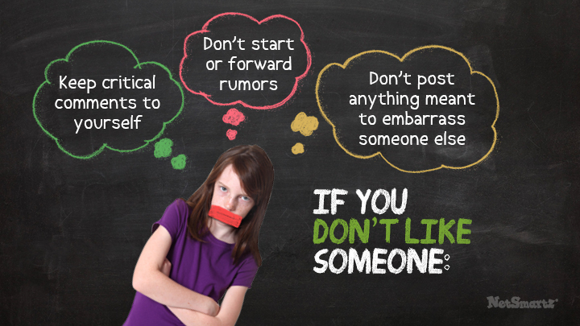



Notes:
You don’t have to be best friends with everyone. You might have different interests or personalities, but that doesn’t mean you have to be mean to them. Here are some ways you can avoid becoming a cyberbully yourself:
Keep critical comments to yourself - It’s not OK to intentionally hurt someone.
Don’t start or forward rumors - Even if you think you’re being funny, rumors can get out of control and can be very hurtful.
Don’t post anything meant to embarrass someone else - It’s not just your friends who can see something mean you’ve posted online; mean comments like that can travel fast and cause a lot of harm.
Remember that if you cyberbully someone, there are consequences:
Your account can be deleted by a website if you break their rules.
You can get in trouble at school if you are cyberbullying a classmate. Some kids have been suspended or kicked off of school sports teams for cyberbullying.
You might have to talk to the police if someone reports the cyberbullying to them. Some kids have even been charged with crimes for harassing others online.
Examples from the news
More than 20 middle school students in WA were suspended for joining a club on Facebook targeting another student.⁷
5 NC teens were arrested for cyberbullying. They had to complete a class educating them about cyberbullying, and they were banned from using social media for a year.⁸
3 IN middle school students were expelled for cyberbullying on Facebook. They had posted messages describing how they would kill other students and a teacher, but claimed it was all a joke.⁹

Slide 33

Notes:
Cyberbullying is not a problem that we can just ignore. It’s a serious issue and everyone needs to work together to make it stop:
Take steps to protect yourself if it happens to you.
Speak up if you see it happening to someone else.
Above all, be kind to one another.
Suggested activity
If you are presenting at a school that has its own cyberbullying/bullying policy, review the policy with students so they understand what is expected of them.

Slide 34
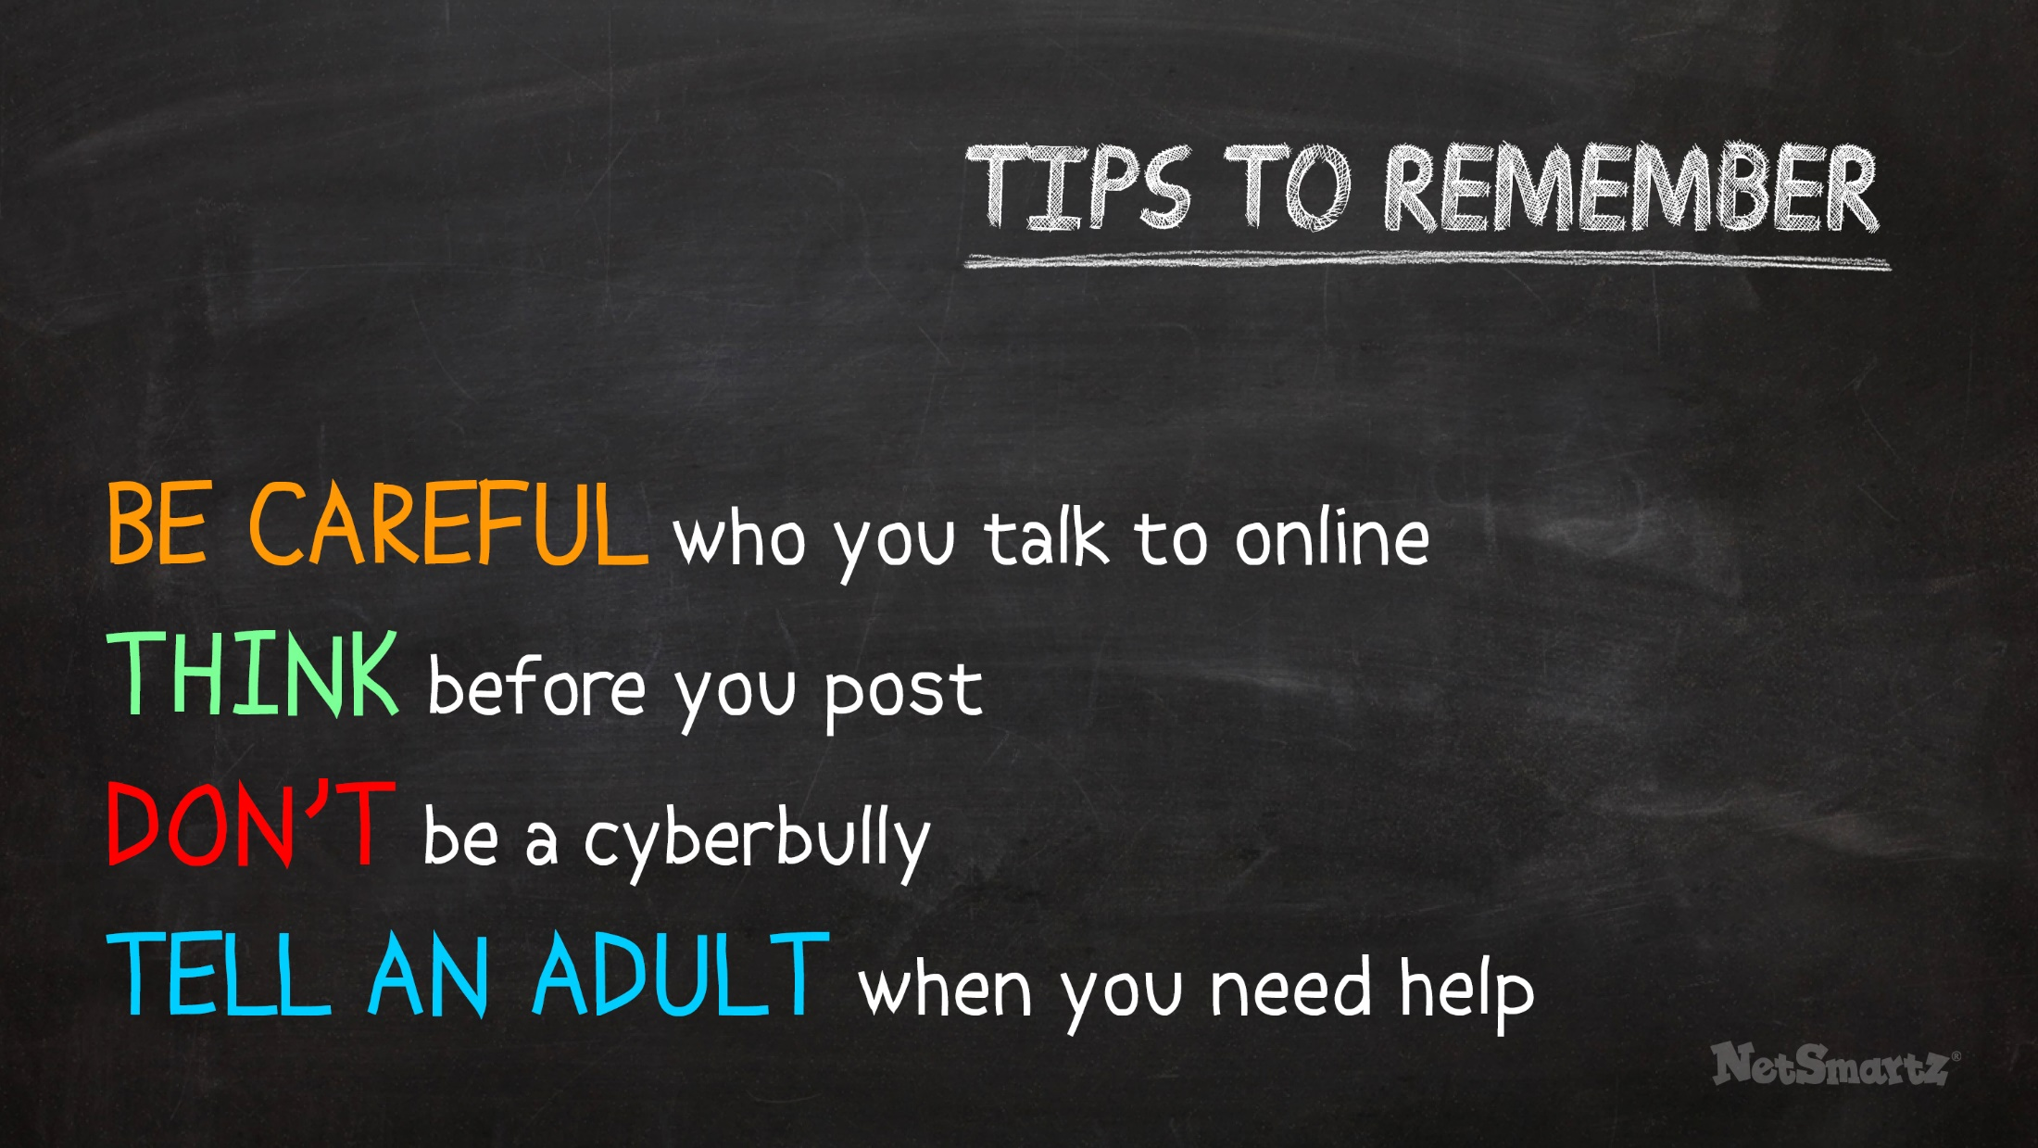
Notes:
Today we talked about many different ways you can be safer online. Here are some of the most important tips to remember:
Be careful who you talk to online - Adults you don’t know should not be contacting you.
Think before you post personal information or something that could be inappropriate - You might regret it later.
Don’t be a cyberbully - Even if you don’t like someone, it’s never OK to be mean.
Tell an adult when you need help - Even if you just need someone to talk to, adults can help!

Slide 35

Notes:
Most kids already avoid the risks we talked about and are responsible about what they do online:
They don’t meet with people they met online.
They don’t post inappropriate information or pictures.
They don’t cyberbully others.
Even though you’re probably already doing these things, your parents and teachers still worry because they hear a lot of stories on the news about what can go wrong. Show them you know what you’re doing! They’ll feel confident that you’re being responsible online and you’ll feel confident turning to them when you need help.

Slide 36

Notes:
Thank you.

Slide 37
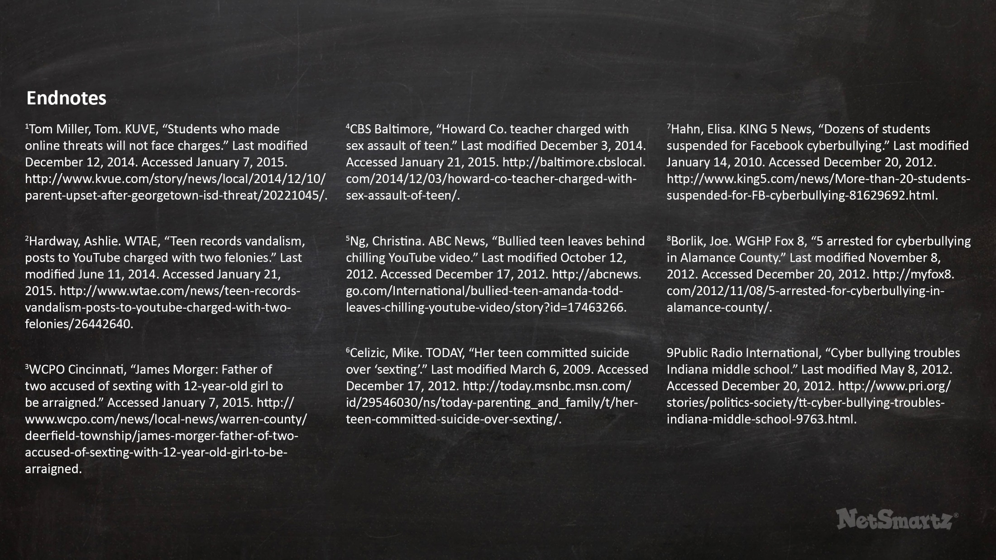

Slide 38
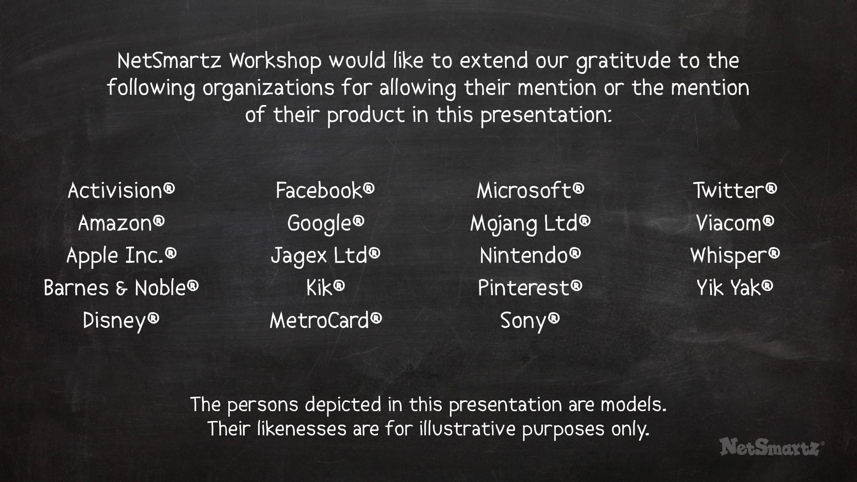

Slide 39


